Slide 1

Clean Air for Everyone
Affordable Air Filter Solution

Slide 2
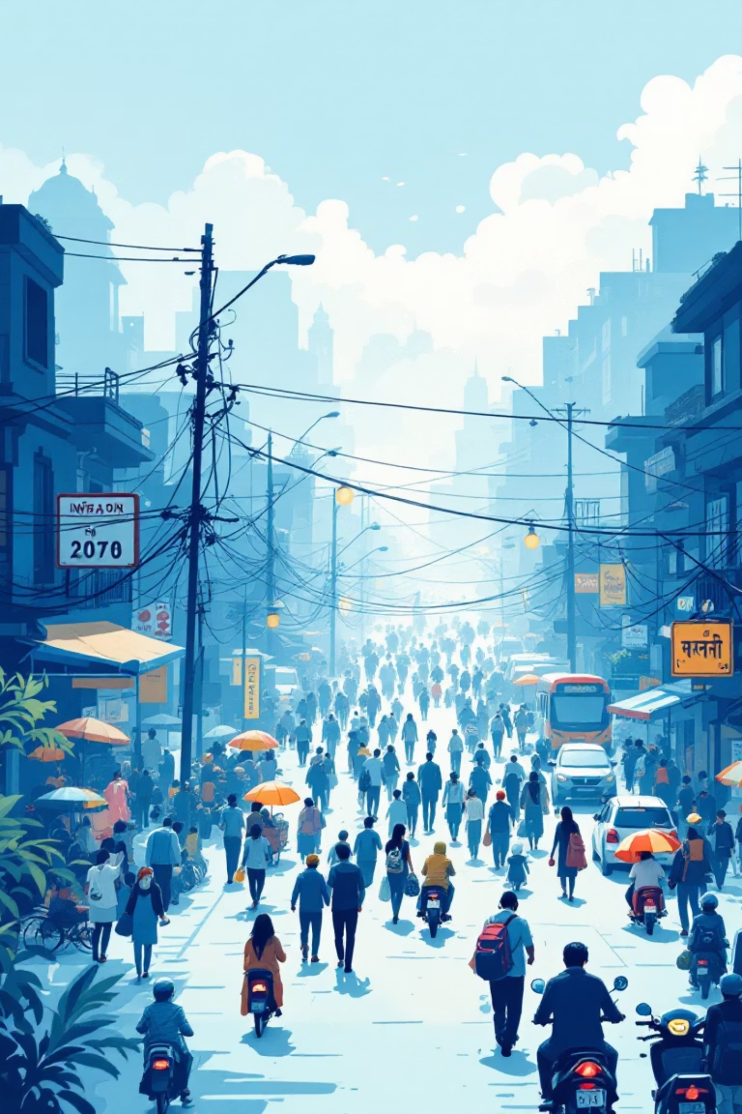
The Problem
Unhealthy Air
Unaffordable
Urban India faces dangerous PM2.5 & PM10 levels
Purifiers cost ₹5,000–₹20,000
Underserved
Students, PG rooms, small shops lack options

Slide 3
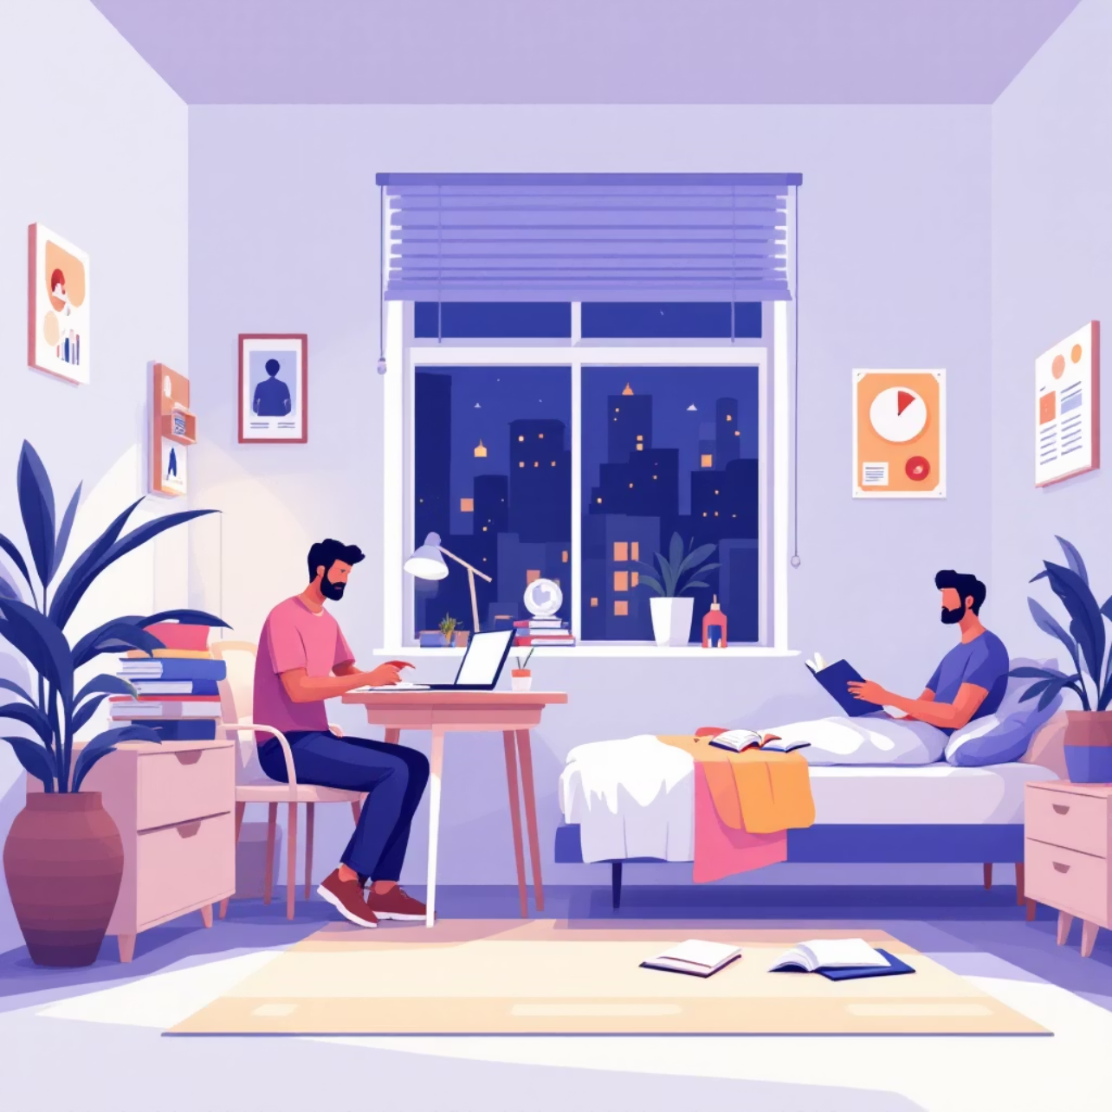
Market Opportunity
₹3000Cr+
₹500-1200
Market Size
Price Gap
India air purifier market
Huge potential in budget segment
Target Users
Students & hostels
Small rooms
Middle & low-income homes
Fastest growth in budget + portable segment

Slide 4


Existing Solutions & Gaps
HEPA Purifiers
Cheap Purifiers
No Standards
Too expensive for most Indians
Weak performance, unreliable
Lack of reliable budget filters
The Gap
High-Performance + Affordable

Slide 5
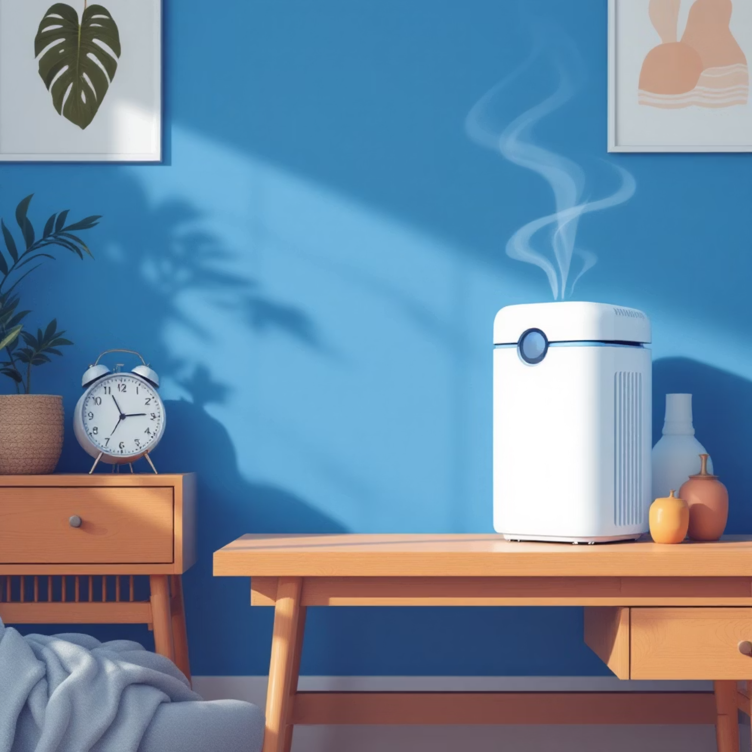




Our Solution
₹999-₹1499
Compact Affordable Air Filter
Multi-Layer Filtration
Perfect for Small Spaces
Effective AQI reduction
3×3×3 m coverage
Low Energy
Long-Lasting
10–18W consumption
Low running cost

Slide 6
Product Breakdown
01
02
Pre-Filter Layer
Fine Microfiber Layer
Traps dust, hair, PM10 • Protects inner layers
Captures PM2.5 • Main filtration layer
03
04
Activated Carbon Layer
High Airflow Fan Unit
Removes odour, smoke, VOCs • Optional add-on
Low-watt motor • Strong circulation
05
06
Replaceable Filter Pack
Durable Frame
Easy to replace • Very low maintenance cost
Lightweight • Plastic/hardboard options

Slide 7




Value Proposition
85–90%
10× Less
Pollution reduction
Than branded purifiers
5–6 Months
Very Low
Filter lifespan
Electricity usage
Simple, compact, reliable

Slide 8
Business Model
Revenue Streams
Distribution Channels
Air Filter Unit
Local retail & online stores
Bulk orders (hostels, schools, offices)
Primary product sales
Marketplace listings
Replacement Filter Packs
Recurring revenue
Carbon+ Premium Models
Higher margin products

Slide 9










Go-To-Market Strategy
Partnerships
Product Demos
Hostels & colleges
Reels, Shorts, social media
Marketplaces
Amazon, Flipkart, Meesho
Local Distribution
Shop partnerships
Influencer Marketing
Micro-influencers
Our Competitive Advantage
Lowest cost • Simple design • Low-cost replacement filters
Competitors: Mi, Philips, Dyson, generic purifiers

Slide 10
Our Vision
Clean air should be accessible to everyone
Mission: Build India's most affordable, widely available air filtration systems
FOUNDER- REHAN KASIM
MARKETING LEAD - HARSH
Technical Development
Branding & Outreach
Thank You

